Slide 1

HR Employee Predictions
Lachandra Ash

Slide 2
Agenda
Predicting the amount of time an employee worked within a specific department.
Revealing employee promotions.
Displaying employee salaries.
Number of employees in each department.
Departments satisfaction levels.
Utilizing models to predict employee stay in the departments.

Slide 3
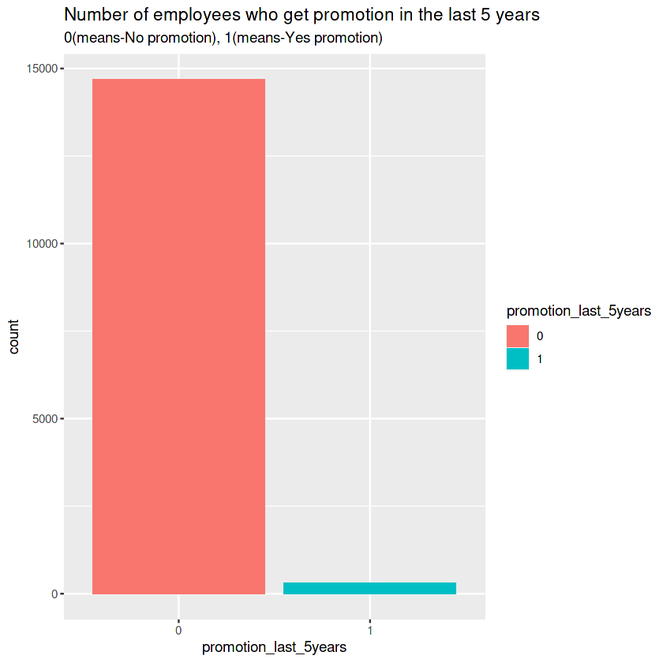
Number employees who received promotions within the last 5 years
Most of the employees did not receive a promotion within the past five years.

Slide 4
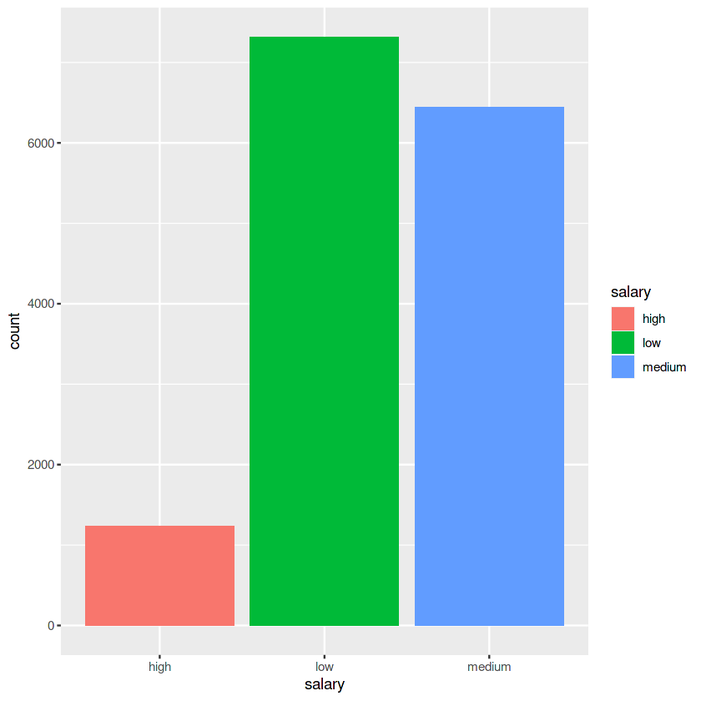
Employee Salary Percentage
Most of the employees received lower salaries.

Slide 5
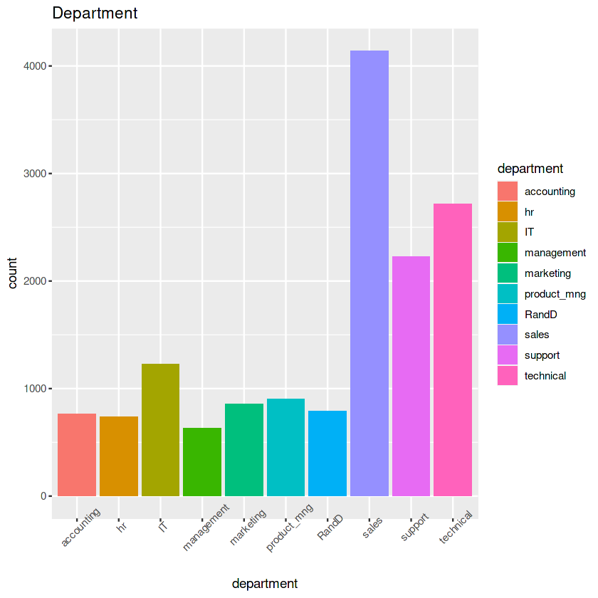
Number of Employees in Each Department
The sales and technician departments has the greatest number of employees.
Management has the least number of employees.

Slide 6
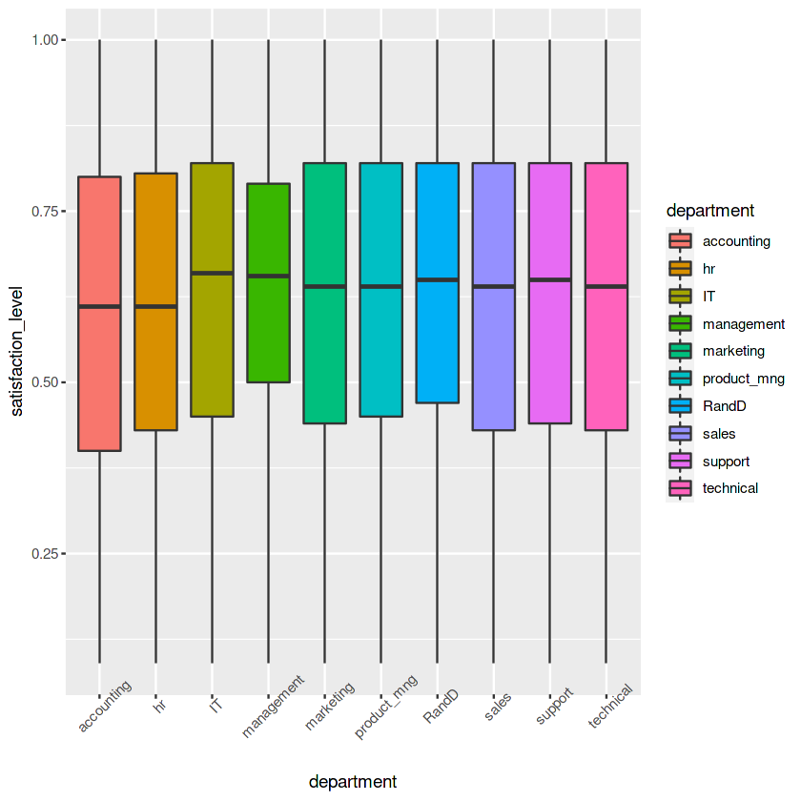
Satisfaction Level in each department
The IT, management, product mng, RandD, sales, support, and technical departments has approximately the same satisfaction level.

Slide 7
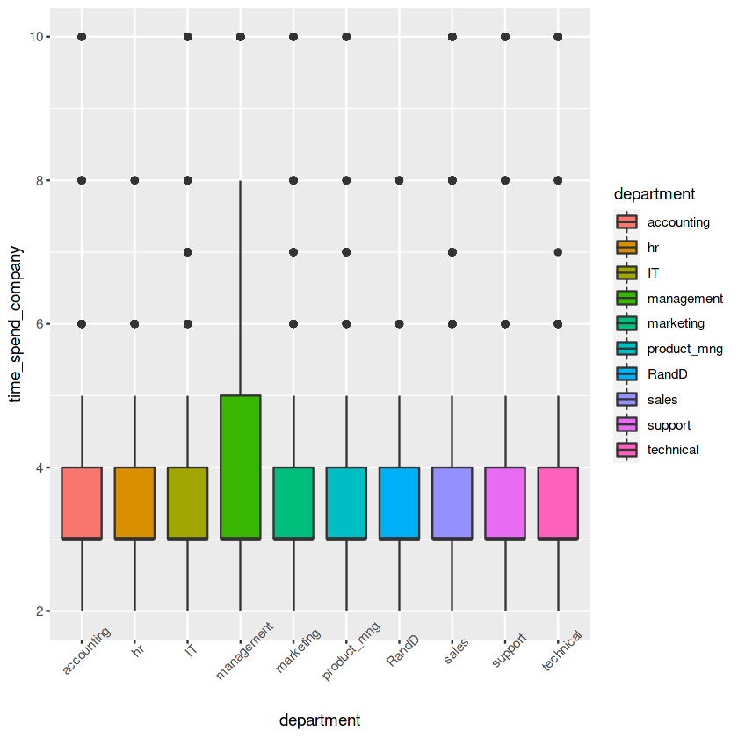
Employee time Spent with the company
The employees in management spent the most time working with the company.
The employees in the other departments spent the least amount of time working with the company.

Slide 8

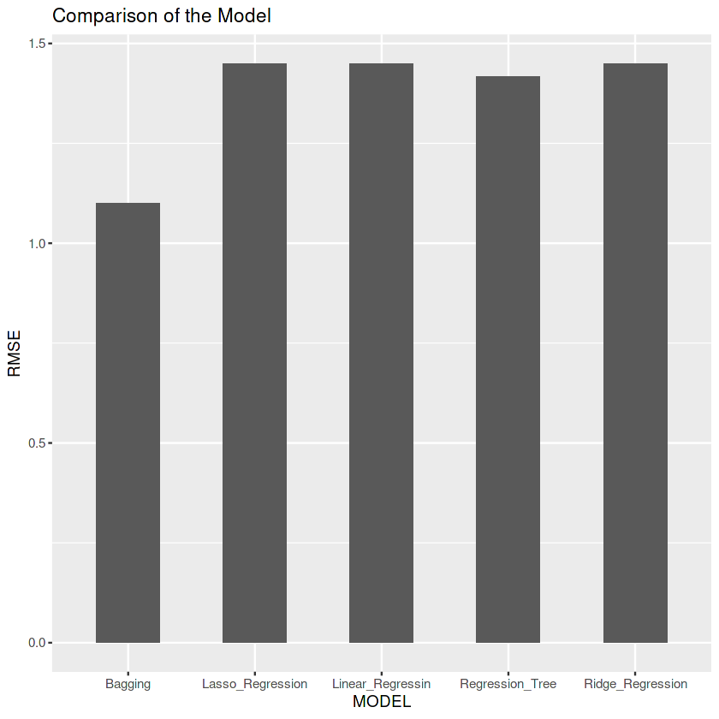
Models Used for employee PRedictions
The regression models were the best models to use to predict employment versus the bagging method.

Slide 9

Conclusion
Management needs to increase the employee salaries to keep them longer with the company.
Management should promote their employees to keep them longer within the company.
Management needs to deploy strategies to keep their employees, so they won’t have to invest money in training new employees.

